Slide 1

The Operating System
for Telehealth Brands.
Your health, always within reach.
Matthew Rose | Account Manager | mattyrose88@gmail.com
Notes:
Welcome. Introduce yourself and CloudHealth. Quick origin story: CloudHealth was built powering Dermifi — a successful white-labeled dermatology telehealth brand. We've now opened that same infrastructure to all telehealth verticals: weight loss, men's health, women's health, peptide therapy, and more. Today I'll show you how that platform can launch YOUR brand in weeks, not months.

Slide 2

Today's Agenda
01
The Problem
04
Medication Formulary
Why the fragmented telehealth stack is costing you.
Semaglutide, Tirzepatide, peptides & more.
02
CloudHealth Platform
05
Pricing Overview
One unified OS replacing your 10-tool patchwork.
Transparent platform and Rx fee structure.
03
Feature Walkthrough
06
Next Steps
From quiz builder to analytics dashboard.
What a launch looks like — weeks, not months.
Notes:
Walk the prospect through what they'll see today. Set expectations: by the end of this call they'll have a clear picture of the platform, the formulary, and what it takes to launch. Ask: 'Is there anything specific you want to make sure we cover today?'

Slide 3
You don't have a telehealth problem.
You have a stack problem.
Website / Funnel
Quiz Platform
EMR / EHR
Provider Sched.
Prescription Hub
Pharmacy Portal
Shipping Tracker
Payment Processor
Messaging App
CRM / Email
Analytics Tool
HIPAA Compliance
12 disconnected tools. Weeks of manual coordination. Revenue falling through the cracks.
Notes:
This is the core insight slide. Most telehealth brands are stringing together 10-15 different tools to run their patient journey. Each handoff is a failure point — lost patients, delayed Rx, compliance gaps, and burned-out staff. Ask: 'How many tools does your team currently use to run a patient from signup to refill?' Pause. Let it land.

Slide 4
The Telehealth Revolution Is Here.
The brands that launch on the right infrastructure now will dominate.
$186B
7x
38M+
Global telehealth
market by 2026
Growth in telemedicine
since 2019
US adults using
telehealth monthly
Notes:
Set the context. This isn't a niche market — it's a $186B industry growing at 7x since pre-COVID. The window to establish a strong brand is NOW, before category leaders cement their position. CloudHealth gives brands the infrastructure to move fast and scale.

Slide 5
INTRODUCING CLOUDHEALTH
Launch in Weeks
One Platform.
Every Workflow.
From first click
to recurring refill.
Not months. Your white-labeled brand live fast — with zero infrastructure build.
HIPAA-Native
CloudHealth is the complete operating system purpose-built for telehealth brands. White-labeled, HIPAA-native, and ready to power your brand in weeks.
Compliance built into every module from day one — not bolted on as an afterthought.
End-to-End
From patient acquisition quiz to automated prescription refill — all in one platform.
Notes:
This is your pivot from problem to solution. CloudHealth replaces ALL those disconnected tools with one unified platform. Key message: it's purpose-built for telehealth — not a generic SaaS tool adapted for healthcare. And it's 100% white-labeled — your patients never see the CloudHealth name.

Slide 6
The Unified Patient Journey
CloudHealth connects every step — no gaps, no manual handoffs, no dropped patients.
1
2
3
4
5
Discovery
& Intake
Provider
Review
Rx &
Fulfillment
Delivery
& Support
Refill &
Retention
>
>
>
>
Branded quiz captures symptoms, goals & eligibility
Async or live visit with licensed telehealth provider
Prescription sent directly to compounding pharmacy
Order tracked; HIPAA-secure patient messaging
Automated reminders, check-ins & subscription renewals
Notes:
Walk through the patient journey step by step. This is the 'aha moment' slide — prospects realize CloudHealth handles EVERYTHING from the first web visit to the patient's second and third order. Ask: 'Which of these steps is currently causing the most friction for your team?'

Slide 7
The CloudHealth Platform
Six core modules. One seamless platform.
Quiz Builder
Provider Network
Order Management
Branded patient intake forms with branching logic and eligibility screening
Fully managed network of licensed telehealth providers across specialties
End-to-end order tracking from Rx approval to patient's front door
Pharmacy Integration
Secure Messaging
Analytics Dashboard
Direct API connections to compounding pharmacy partners — no middleman
HIPAA-compliant patient-provider communication built into the platform
Real-time insights: revenue, retention, prescribing patterns & patient funnel
Notes:
Give a high-level tour of all six modules. Use this as the 'map' for the demo — you'll go deeper on each one. Ask which modules they're most interested in seeing. Common answers: Analytics, Quiz Builder, Pharmacy integration.

Slide 8
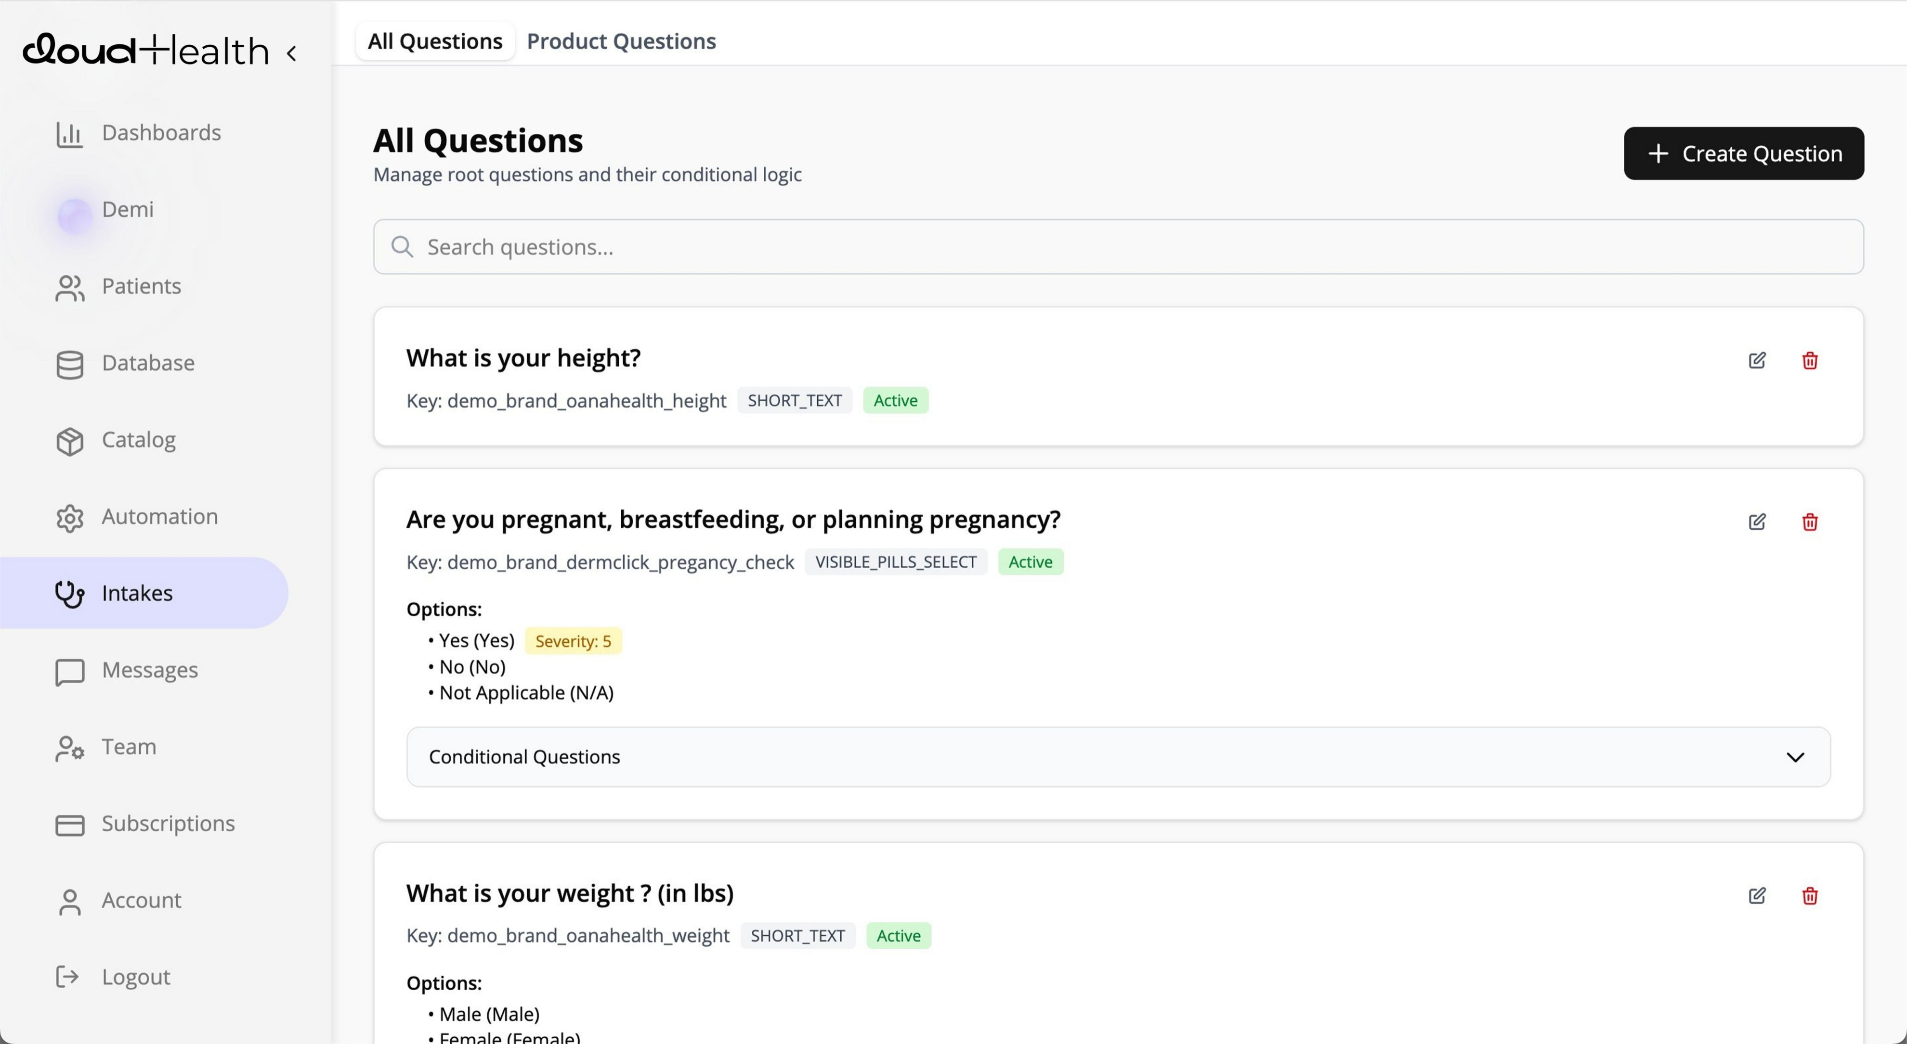
MODULE 01
Quiz Builder
& Patient Intake
Fully branded quiz flows — patients never see CloudHealth
Branching logic routes patients to the right treatment automatically
Medical eligibility screening built directly into the intake flow
Consent and intake forms captured automatically — no extra tool needed
Quiz completion triggers provider review workflow instantly
Notes:
Demo the quiz builder. Show how it's fully white-labeled. Click through a sample patient quiz in the demo environment. Emphasize: the patient sees THEIR brand only. Branching logic is powerful — show how a 'yes' to low testosterone sends the patient down a different path than a 'no'. Ask: 'What patient intake questions are most important to your clinical protocol?'

Slide 9
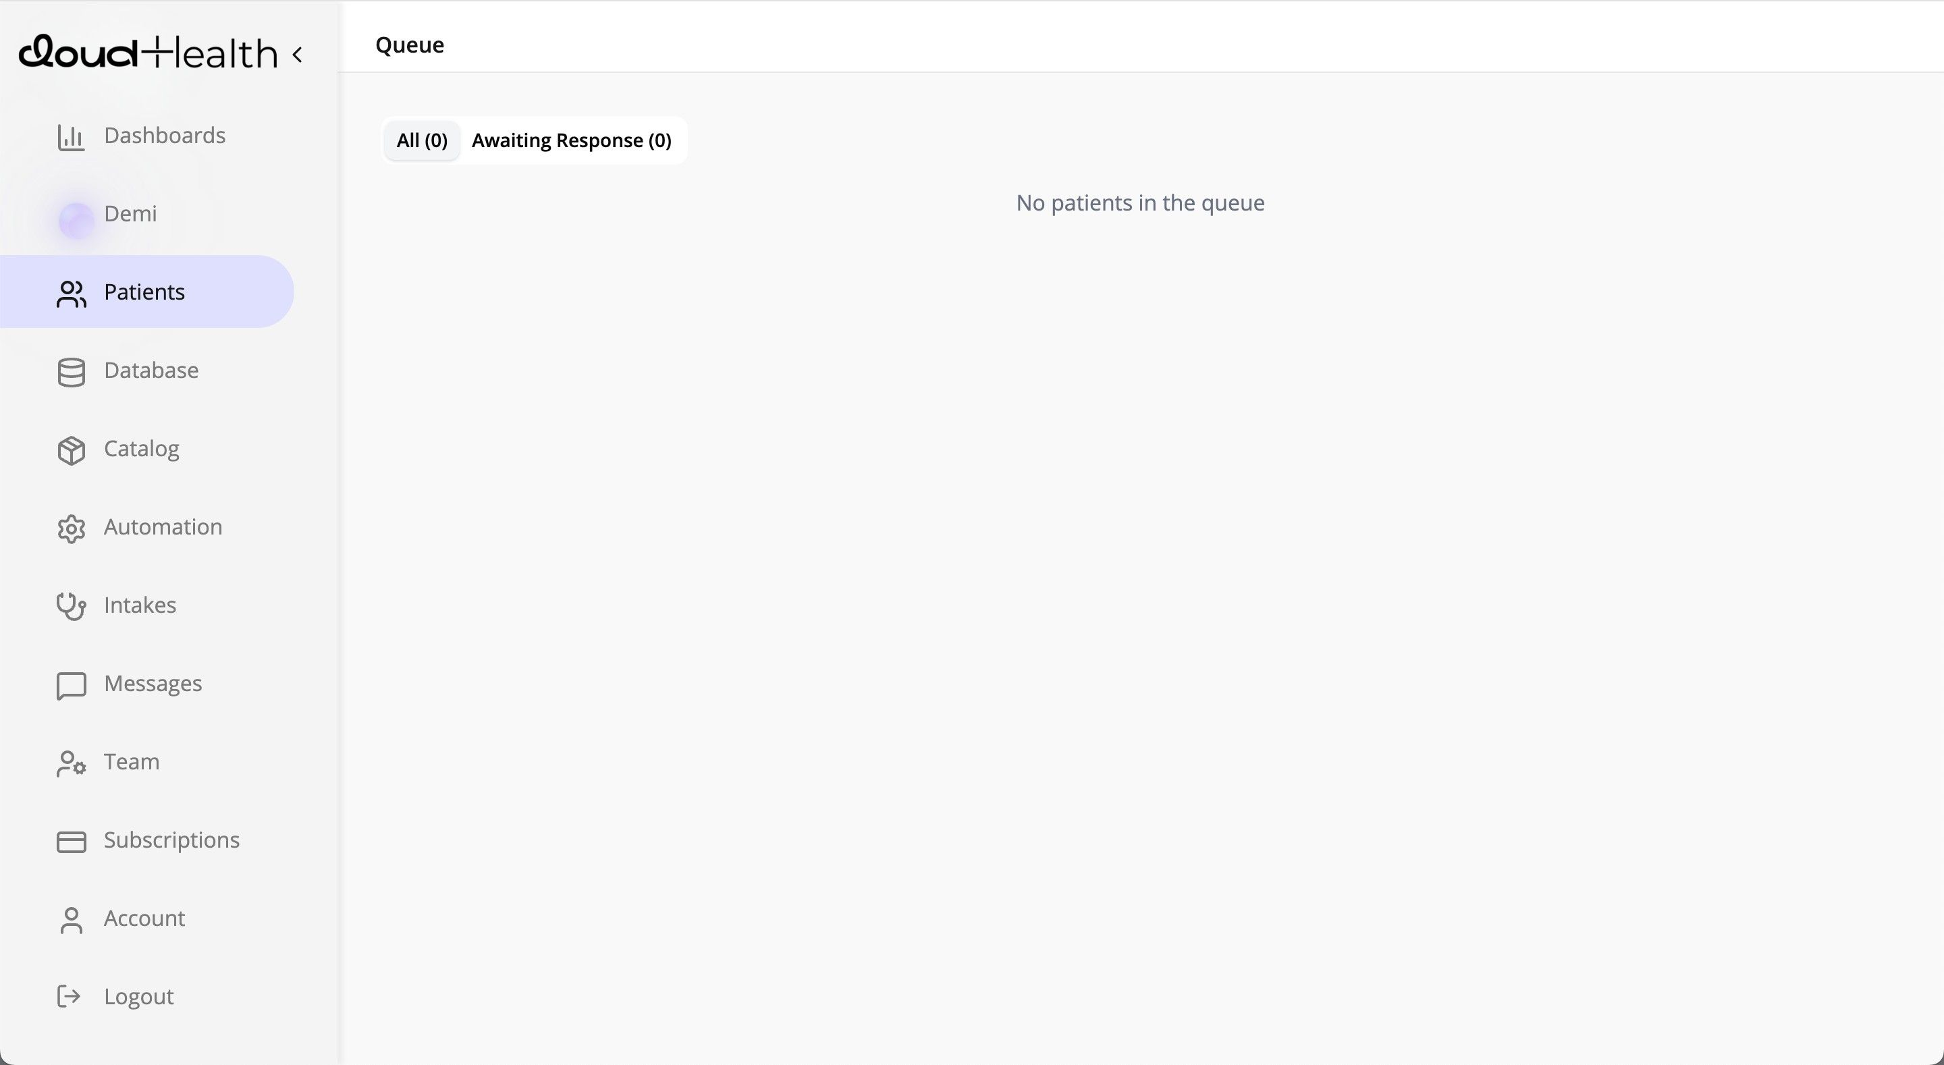
MODULE 02
Provider Network
& Clinical Layer
Licensed provider network available on-demand across specialties
Async and synchronous visit types — video, async review, or hybrid
Specialty coverage: weight loss, men's/women's health, peptides & more
Smart routing assigns patients to available, state-licensed providers
Provider capacity scales automatically with your patient volume
Notes:
The provider network is a major differentiator. Brands don't need to hire, credential, or contract their own providers — CloudHealth's network is available on-demand. Ask: 'Do you currently have provider relationships, or are you looking for us to supply that?' If they have providers, explain they can integrate those too.

Slide 10
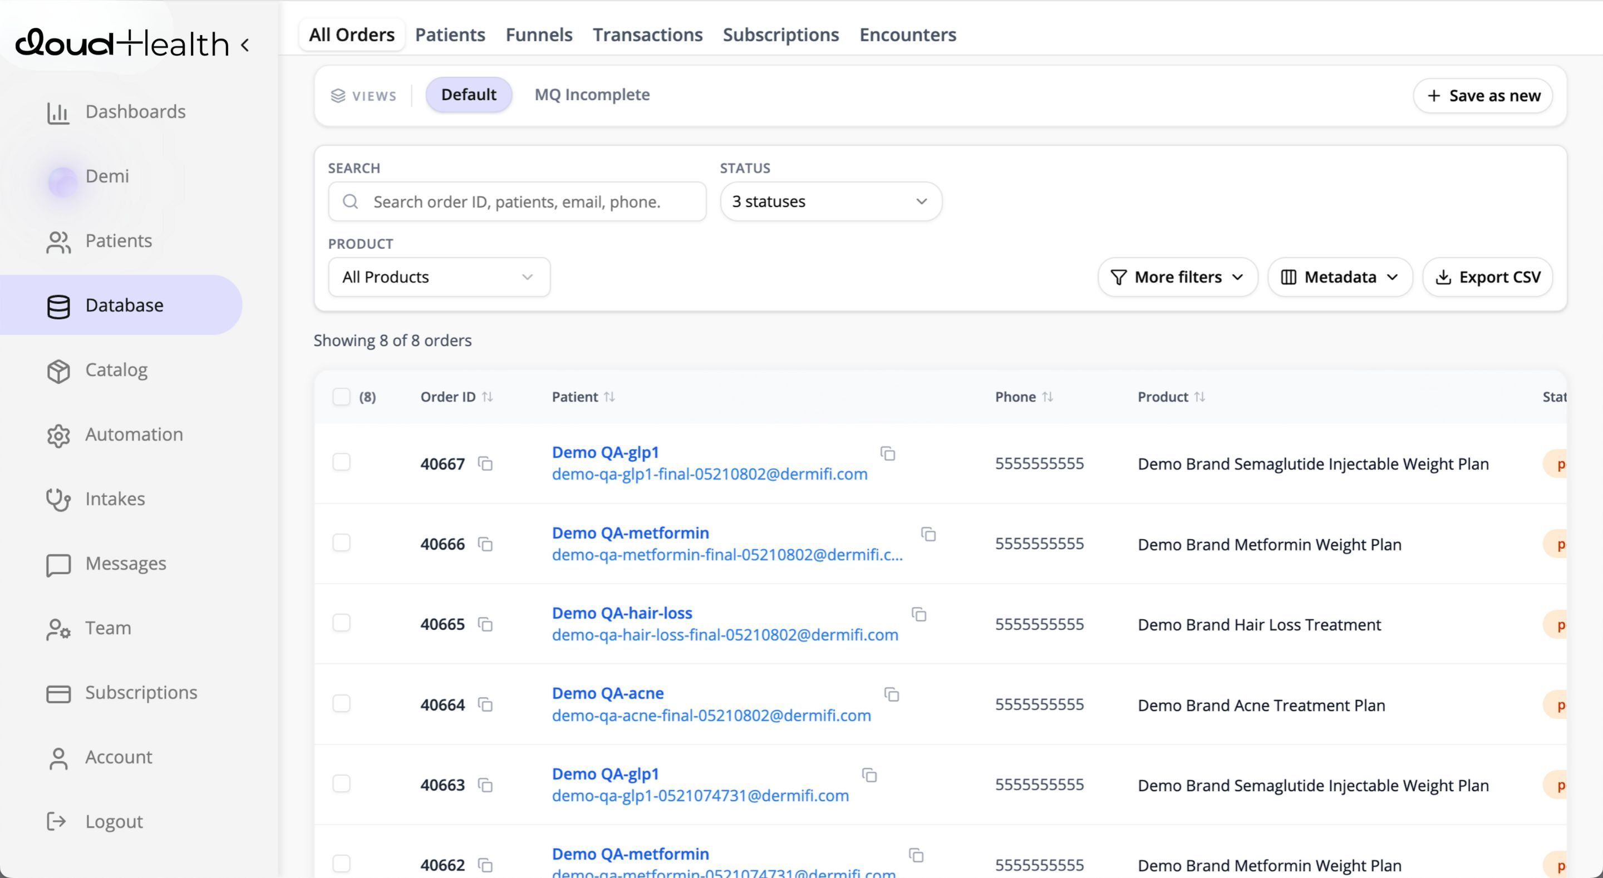
MODULE 03
Order Management
& Pharmacy Integration
Real-time Rx transmission to compounding pharmacy partners
Order status tracking from Rx approval to the patient's doorstep
Automated refill scheduling and subscription management
Supports Semaglutide, Tirzepatide, BPC-157, NAD+, peptides and more
Exception handling for returns and failed deliveries built in
Notes:
This is where the recurring revenue lives. The order management module handles the full fulfillment loop. Key selling point: the automated refill system drives LTV without manual intervention. Show how a patient who approves refill just gets their medication — no re-intake, no new provider visit required unless clinically needed.

Slide 11
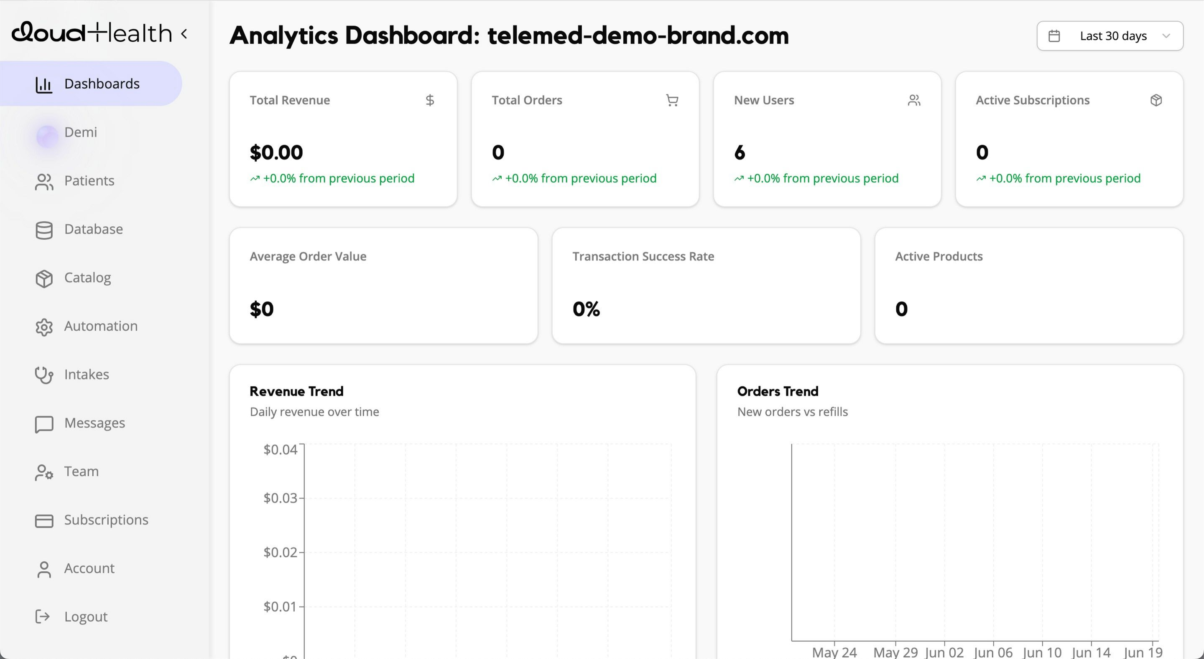
MODULE 04
Analytics &
Insights Dashboard
Revenue analytics — MRR, ARR, and LTV by treatment cohort
Patient funnel conversion rates at each stage of the journey
Prescribing pattern reports by provider, specialty, and volume
Retention and churn metrics with win-back opportunity flags
Clinical outcome tracking tied to patient-reported data
Notes:
Analytics is a huge selling point for growth-minded operators. They want to know what's working and what's not. Walk through the dashboard. Show a sample MRR chart, a funnel conversion view, and a cohort retention curve. Ask: 'What metrics do you currently track manually, if at all?' Pause — the silence is revealing.

Slide 12
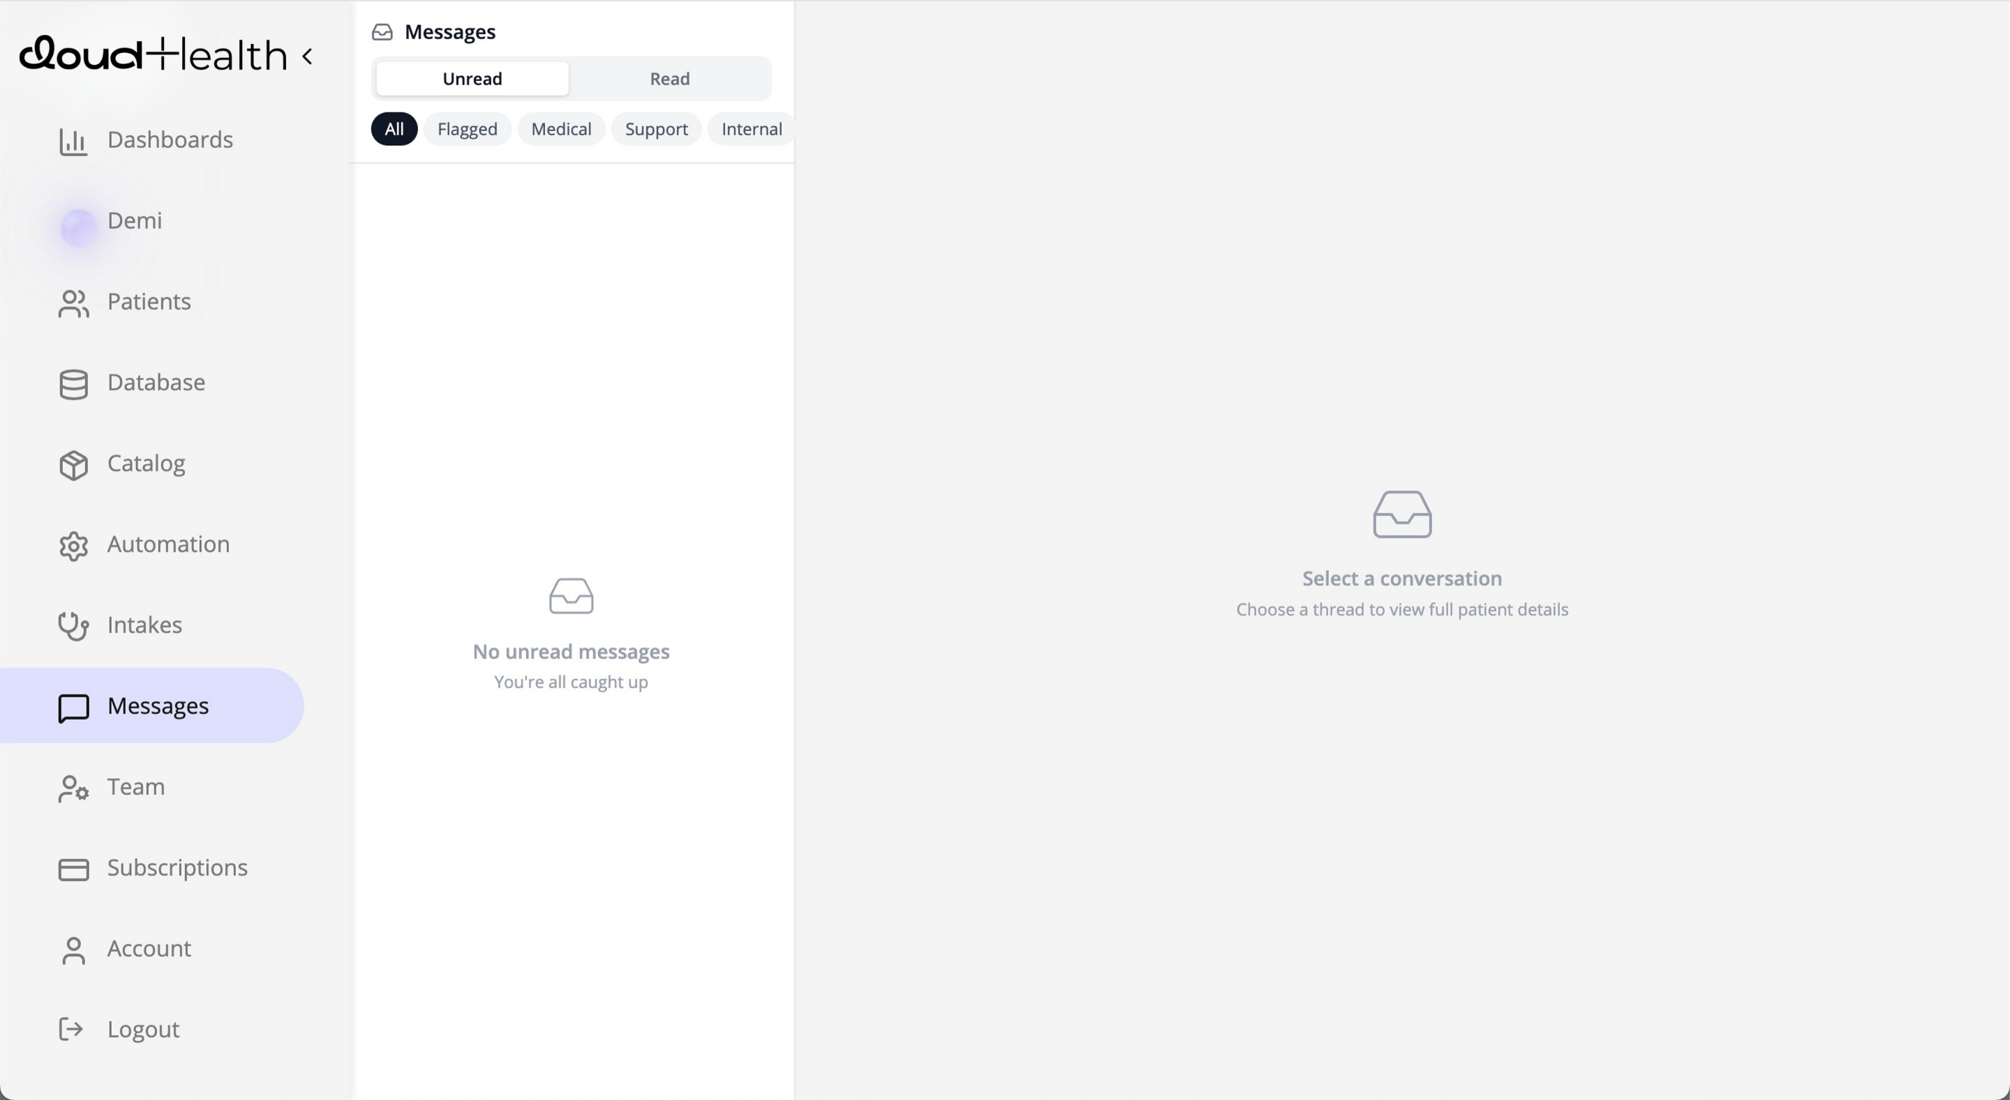
MODULE 05
Secure Messaging
& Patient Support
HIPAA-compliant messaging between patients and providers
Branded patient portal — your logo, colors, and custom domain
Support ticket routing and escalation for your CS team
Automated check-ins and progress prompts drive patient retention
Full message history retained and audit-ready for compliance
Notes:
Patients who can message their provider directly are far more likely to stay on treatment. This module reduces churn while keeping the clinical team informed and compliant. Show how the admin team can monitor and triage conversations. Key point: all of this is under the BRAND's domain — not a generic telehealth app.

Slide 13
Medication Formulary
Powered by our compounding pharmacy partner network
Weight Management
Sexual Health
Semaglutide + B12 (1mg - 10mg)
Tirzepatide + B12 (5mg - 30mg)
PT-141 (Bremelanotide)
For men's and women's sexual wellness
Peptide Therapies
Metabolic & Hormonal
BPC-157 | CJC-1295 / Ipamorelin
Sermorelin | Tesamorelin | MOTS-C
Sermorelin | Custom hormonal compounds
Blood panel-guided protocols
NAD+ & Cellular
Specialty Compounds
NAD+ IV / SQ | GHK-Cu (copper peptide)
Glutathione | LIPO-B
Custom formulations available on request
Brand-specific formulary options
Full formulary & pricing: cloudhealth-pricing.lovable.app
Notes:
This slide shows the breadth of the formulary. Key message: brands can choose a focused formulary (e.g., GLP-1 weight loss only) or a broad catalog. The compounding pharmacy handles manufacturing and shipping. Dosages are customizable. Ask: 'What treatment lines are you planning to launch with?' This helps scope the custom proposal.

Slide 14
Your Brand. Our Infrastructure.
CloudHealth is 100% white-labeled — your patients never see our name.
What your brand gets:
Origin: Dermifi
Now: All Telehealth
Branded patient portal with your custom domain
White-label model
first proven in
dermatology telehealth
Weight loss
Men's health
Women's health
Peptide therapy
+ more
Your logo, colors, and brand voice throughout
>
Custom email & SMS templates from your sender name
No 'Powered by CloudHealth' watermarks anywhere
Full API access for deep integrations
Dedicated account manager for your launch
Notes:
The white-label model is a critical differentiator. The brand OWNS the patient relationship. Everything the patient sees is the brand's identity. CloudHealth is the invisible infrastructure layer. This is exactly how Dermifi built their successful dermatology brand — and now CloudHealth is open to all telehealth verticals.

Slide 15
Built for Compliance.
Not an Afterthought.
HIPAA
Compliant
HIPAA compliance, data security, and regulatory infrastructure are core to CloudHealth's architecture — not features bolted on later.
HIPAA-Native Architecture:
Built in.
Not bolted on.
PHI encrypted at rest and in transit. BAA executed on day one.
SOC 2 Ready Infrastructure:
Enterprise-grade data security — built for investor scrutiny.
State-by-State Licensing:
Provider licensing tracked and verified by state, automatically.
Audit-Ready Activity Logs:
Full trail of patient interactions and Rx decisions on demand.
Notes:
Compliance is table stakes in telehealth, but it's often the thing brands try to figure out AFTER they've built everything else — which is very expensive to retrofit. CloudHealth gives you a compliant foundation from day one. This is especially important for brands raising capital or working with enterprise partners who will do due diligence.

Slide 16
Pricing Overview
Transparent, usage-based pricing built for scaling telehealth brands.
Platform & SaaS
Medication & Rx Fees
Custom Proposals
· White-labeled patient portal
· Semaglutide + B12 (dosage-based)
· Dedicated account manager
· Quiz Builder & intake flows
· Tirzepatide + B12 (dosage-based)
· Custom formulary curation
· Provider network access
· BPC-157 & peptide compounds
· Branded launch support
· Order management system
· NAD+ & wellness injections
· Volume-based discounts
· Secure messaging module
· Specialty custom compounds
· Priority provider access
· Analytics dashboard
· Provider consultation fee
· Co-marketing opportunities
· HIPAA infrastructure
· Pharmacy processing & shipping
· White-glove onboarding
Flat platform fee + per-active-patient pricing
Per-prescription — passed to patient or absorbed by brand
Built around your brand's volume and vertical
Full pricing details: cloudhealth-pricing.lovable.app
Notes:
Don't deep-dive on pricing in this meeting — the goal is to show there's a clear, transparent model. Direct them to cloudhealth-pricing.lovable.app for the full breakdown. If they ask for numbers, offer to build a custom proposal based on their volume, formulary, and launch timeline. That customization is part of the value.

Slide 17
Why CloudHealth?
DIY Stack
CloudHealth
Time to Launch
6 – 18 months
2 – 6 weeks
Tools Required
10 – 15 vendors
1 platform
HIPAA Setup
Lawyers + dev work
Built in — day one
Provider Access
Self-sourced
On-demand network
Pharmacy Partners
Self-negotiated
Pre-integrated
Analytics
Manual / Looker
Real-time dashboard
Patient Messaging
Third-party app
Native, HIPAA-safe
Account Manager
None
Dedicated CloudHealth AM
Notes:
Use this comparison to reinforce the build-vs-buy decision. The DIY path is long, expensive, and fragile. CloudHealth is the fastest path to a compliant, scalable telehealth brand. Ask: 'Which of these rows resonates most with where you are right now?' Let them self-identify their biggest pain point — then address it directly.

Slide 18
Ready to Launch?
Your white-labeled telehealth brand — live in weeks, not months.
1
2
3
4
Platform Demo
Custom Proposal
Technical Scoping
Launch!
30-min live walkthrough in a branded demo environment
Tailored pricing based on your formulary and volume
Map your workflow with our solutions team (30 min)
Go-live in as little as 2-6 weeks from signed agreement
Matthew Rose | Account Manager
mattyrose88@gmail.com | www.joincloudhealth.com
Notes:
Close with clear next steps. Goal: leave this meeting with a specific follow-up action confirmed. Best case: schedule the live platform demo before you hang up. Second best: set a date to deliver a custom proposal. Never leave without something concrete on the calendar. Ask: 'Which of these steps makes the most sense for where you are right now?'

